Slide 1
Housing Project
Problem Statement-
Houses are one of the necessary need of each and every person around the globe and therefore housing and real estate market is one of the markets which is one of the major contributors in the world’s economy. It is a very large market and there are various companies working in the domain. Data science comes as a very important tool to solve problems in the domain to help the companies increase their overall revenue, profits, improving their marketing strategies and focusing on changing trends in house sales and purchases. Predictive modelling, Market mix modelling, recommendation systems are some of the machine learning techniques used for achieving the business goals for housing companies. Our problem is related to one such housing company.
A US-based housing company named Surprise Housing has decided to enter the Australian market. The company uses data analytics to purchase houses at a price below their actual values and flip them at a higher price. For the same purpose, the company has collected a data set from the sale of houses in Australia. The data is provided in the CSV file below. The company is looking at prospective properties to buy houses to enter the market. You are required to build a model using Machine Learning in order to predict the actual value of the prospective properties and decide whether to invest in them or not. For this company wants to know:

Slide 2
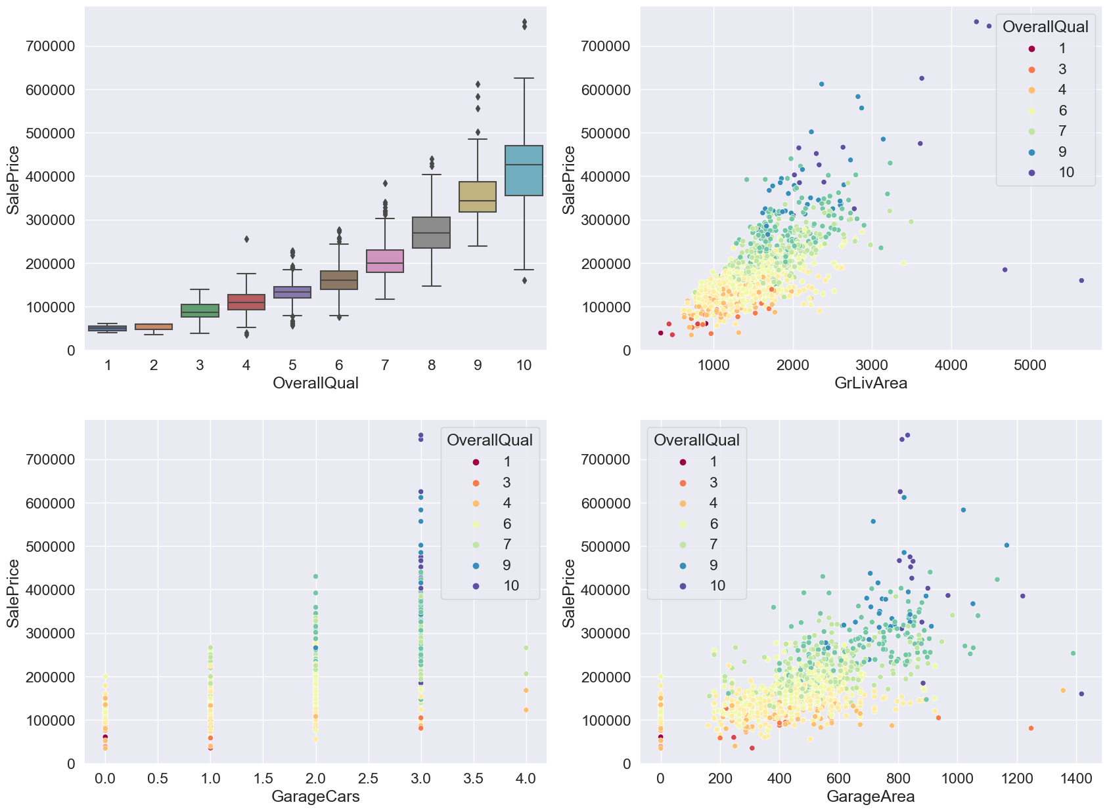
EDA

Slide 3
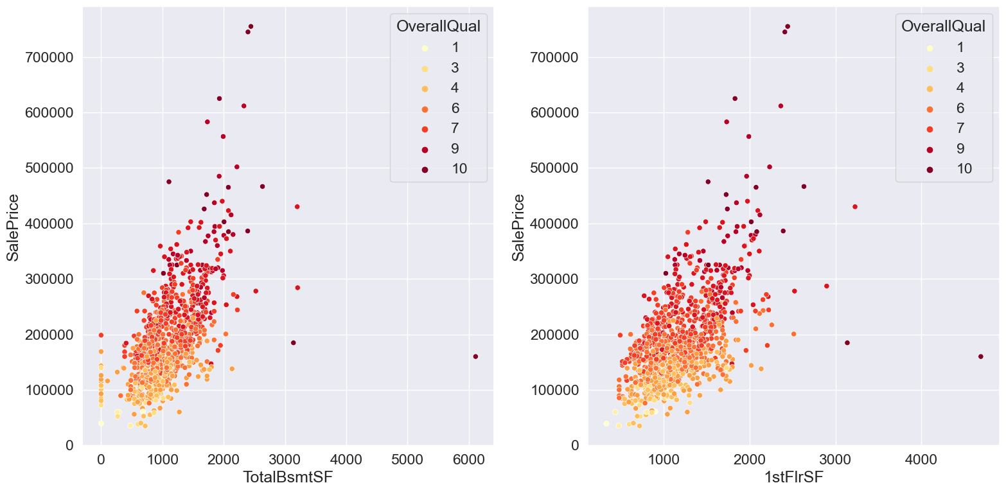
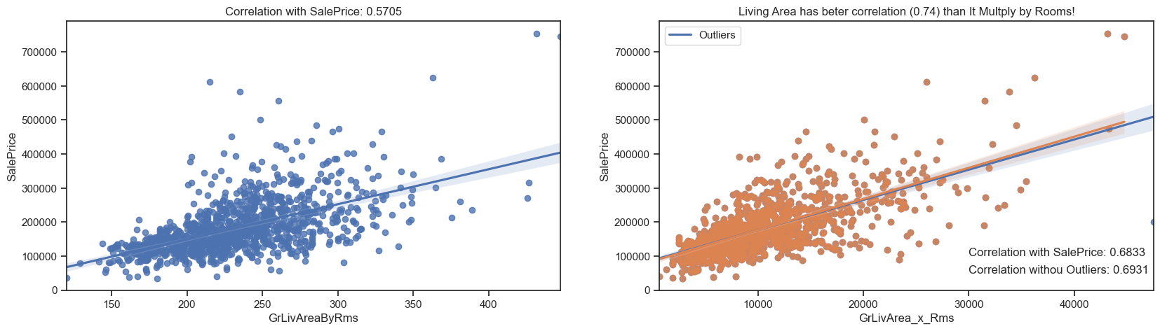
As we can see, the interaction between the two features did not present a better correlation than that already seen in the living area, include it improves to 0.74 with the cut of the outliers. On the other hand, the multiplication not only demonstrated the living area outliers already identified, but it still emphasized another. If the strategy is to drop the TotRmsAbvGrd, we should also exclude this additional outlier.

Slide 4
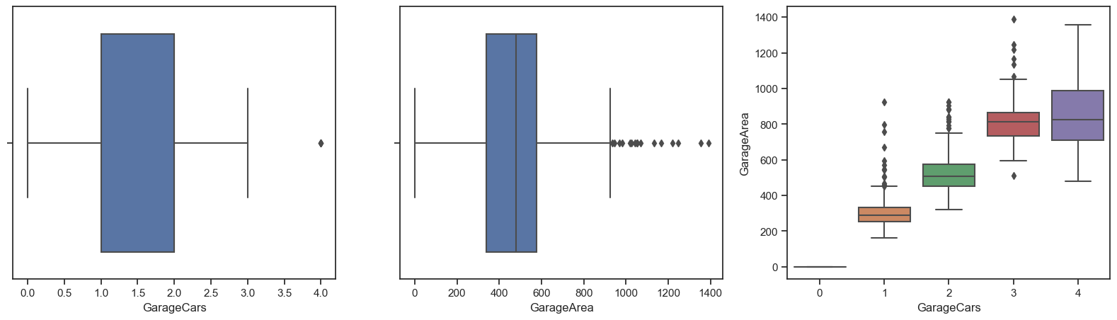
From the boxplot above, we can note that more than 3 parking cars and more than 900 of area are outliers, since a few number of their observations. Although there is a relationship between them, most likely with a smaller number of parking spaces, there may be more garage area for other purposes, reason why the correlation between them is 0.88 and not 1.
Total Rooms above Ground and Living Area

Slide 5
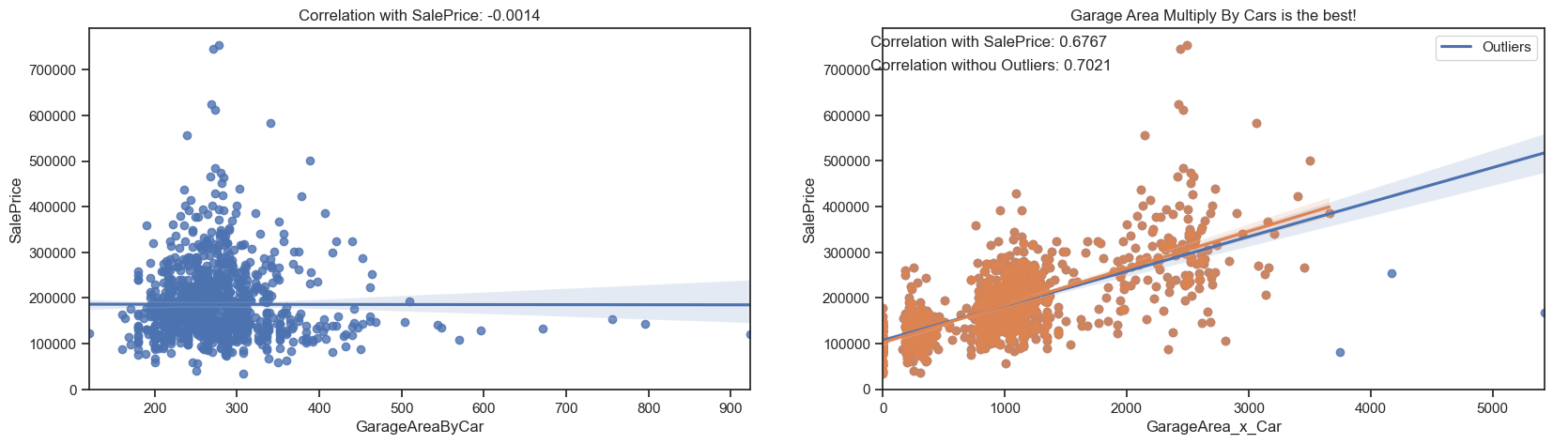
As can be seen the area by car is little useful, but contrary to common sense the multiplication of the area by the number of vacancies yes is. In the division we lose the magnitude and we have to maintain one or another functionality to recover it. With the multiplication we solve the problem of 1 parking space of 10 square feet against another of 10 with 1 square feet each. We could still improve the correlation by 0.06, already considering the exclusion of only 4 outliers. The identification of the outliers was facilitated, note that before we would have a greater number of outliers, since the respective of each features alone are not coincident.
Garage areas and parking

Slide 6
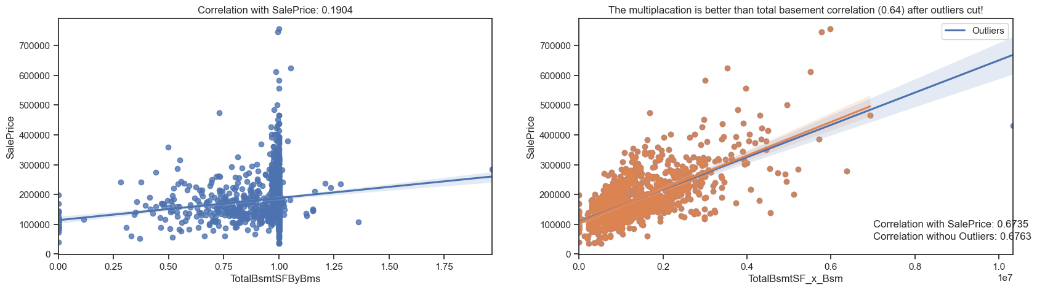
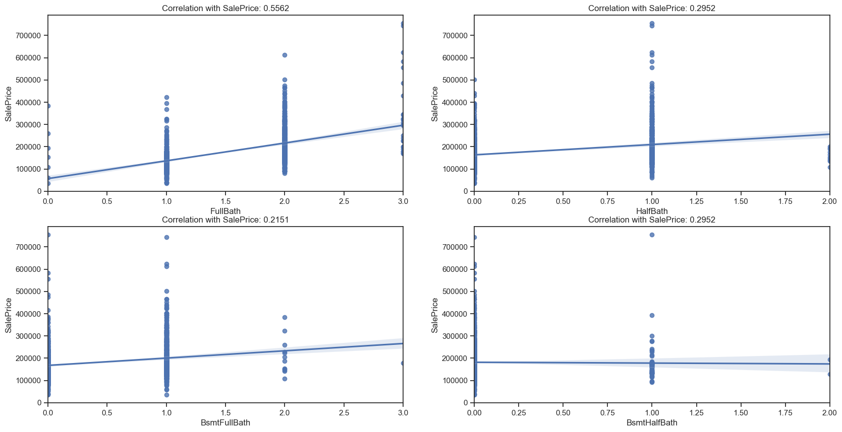
Total Basement Area Vs 1st Floor Area
FullBath has the largest correlation with SalePrice between than. The others individually, these features are not very important.

Slide 7
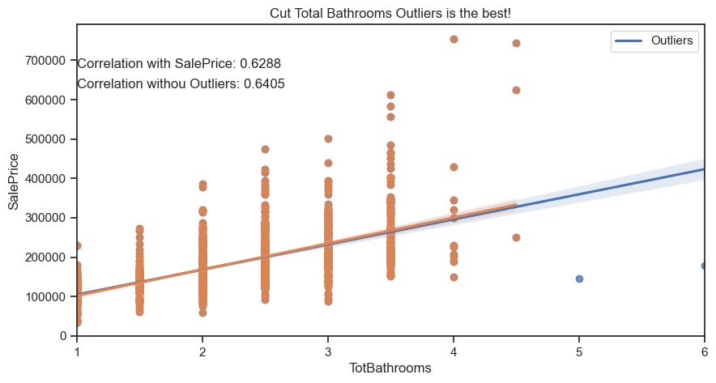
So, with our best predictor, we can cut only two outliers, use it and substitute all others bath features with a existence indicator

Slide 8
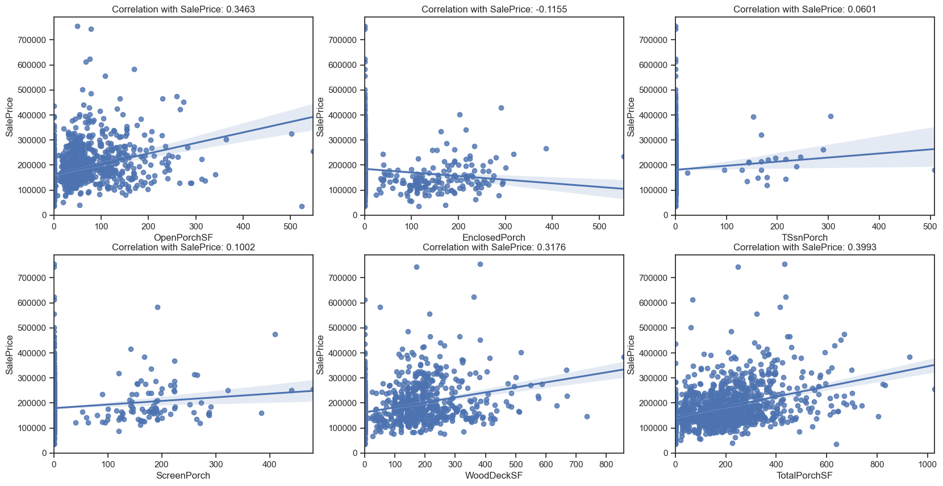
Review Porch Features

Slide 9
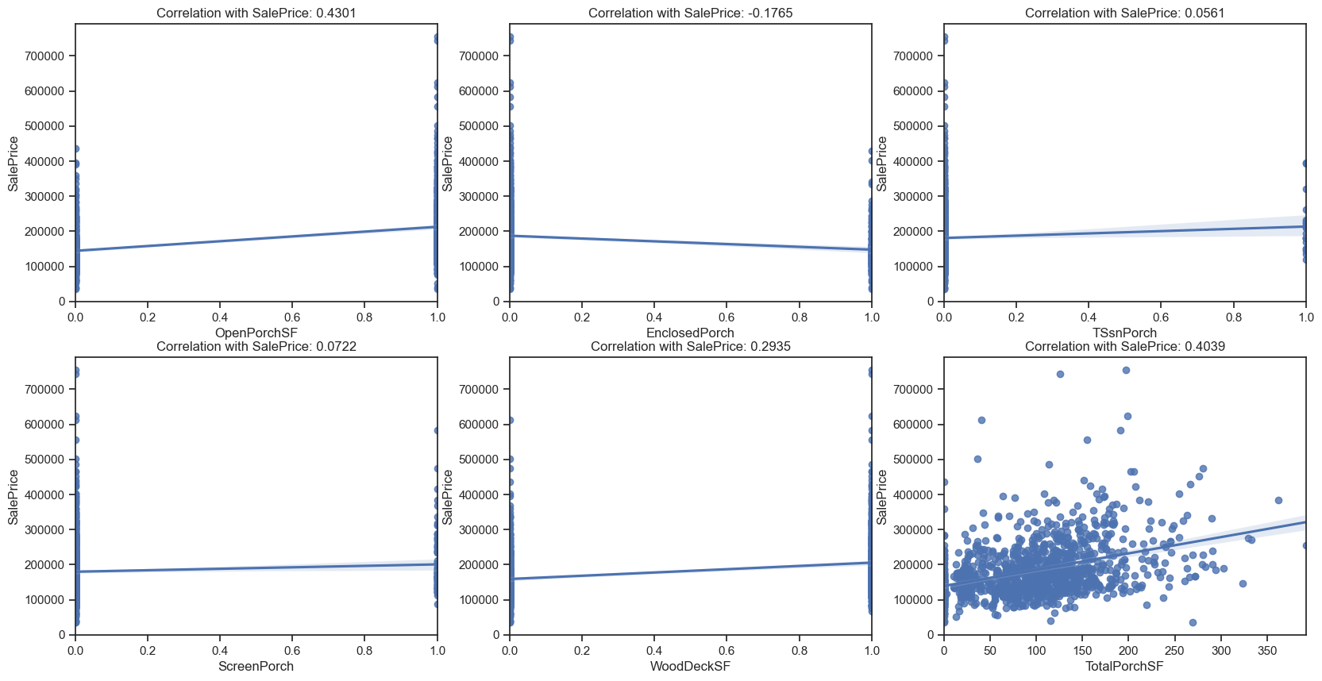
As we have seen, porch features have low correlation with price, and by the graphics we see all most has low bas and high variance, being a high risk to end complex models and fall into over fit

Slide 10
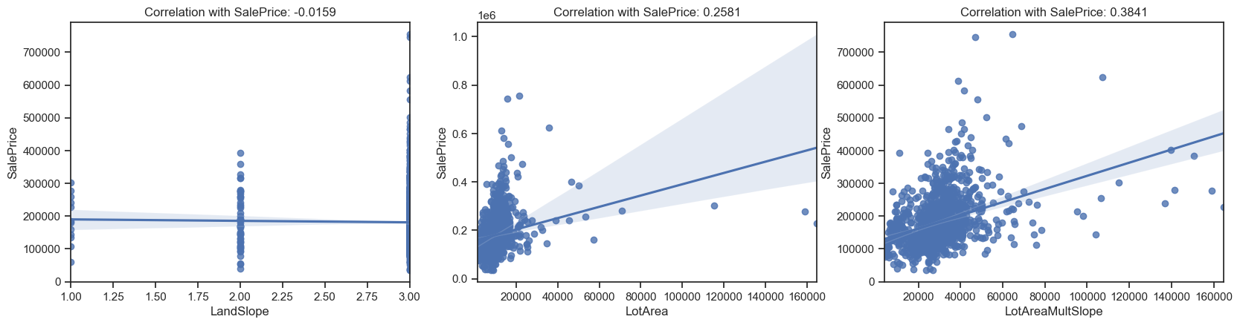
Slope of property and Lot area
It is interesting to note that the slope has a low correlation, but as an expected negative. On the other hand, the lot size does not present such a significant correlation, contrary to the interaction between these two characteristics, which is better and also allow us to identify some outliers. Let's take a look at the effect of removing the outliers.

Slide 11
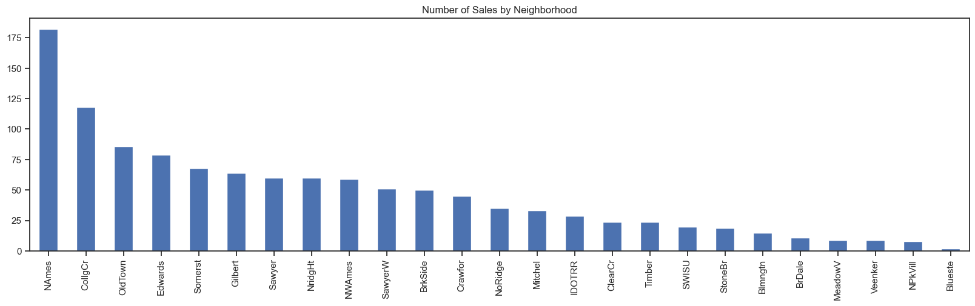
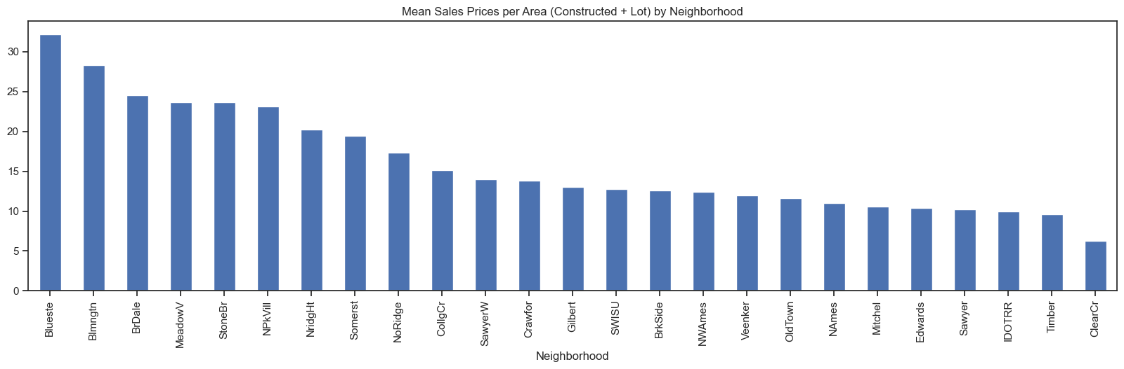
Neighbourhood
As we can see prices are affected by the neighborhood, yes, if more similar more they attract. But we will delve a little and see how the year and month of the sale also has great influence on the price variation and confirm the seasonality.

Slide 12
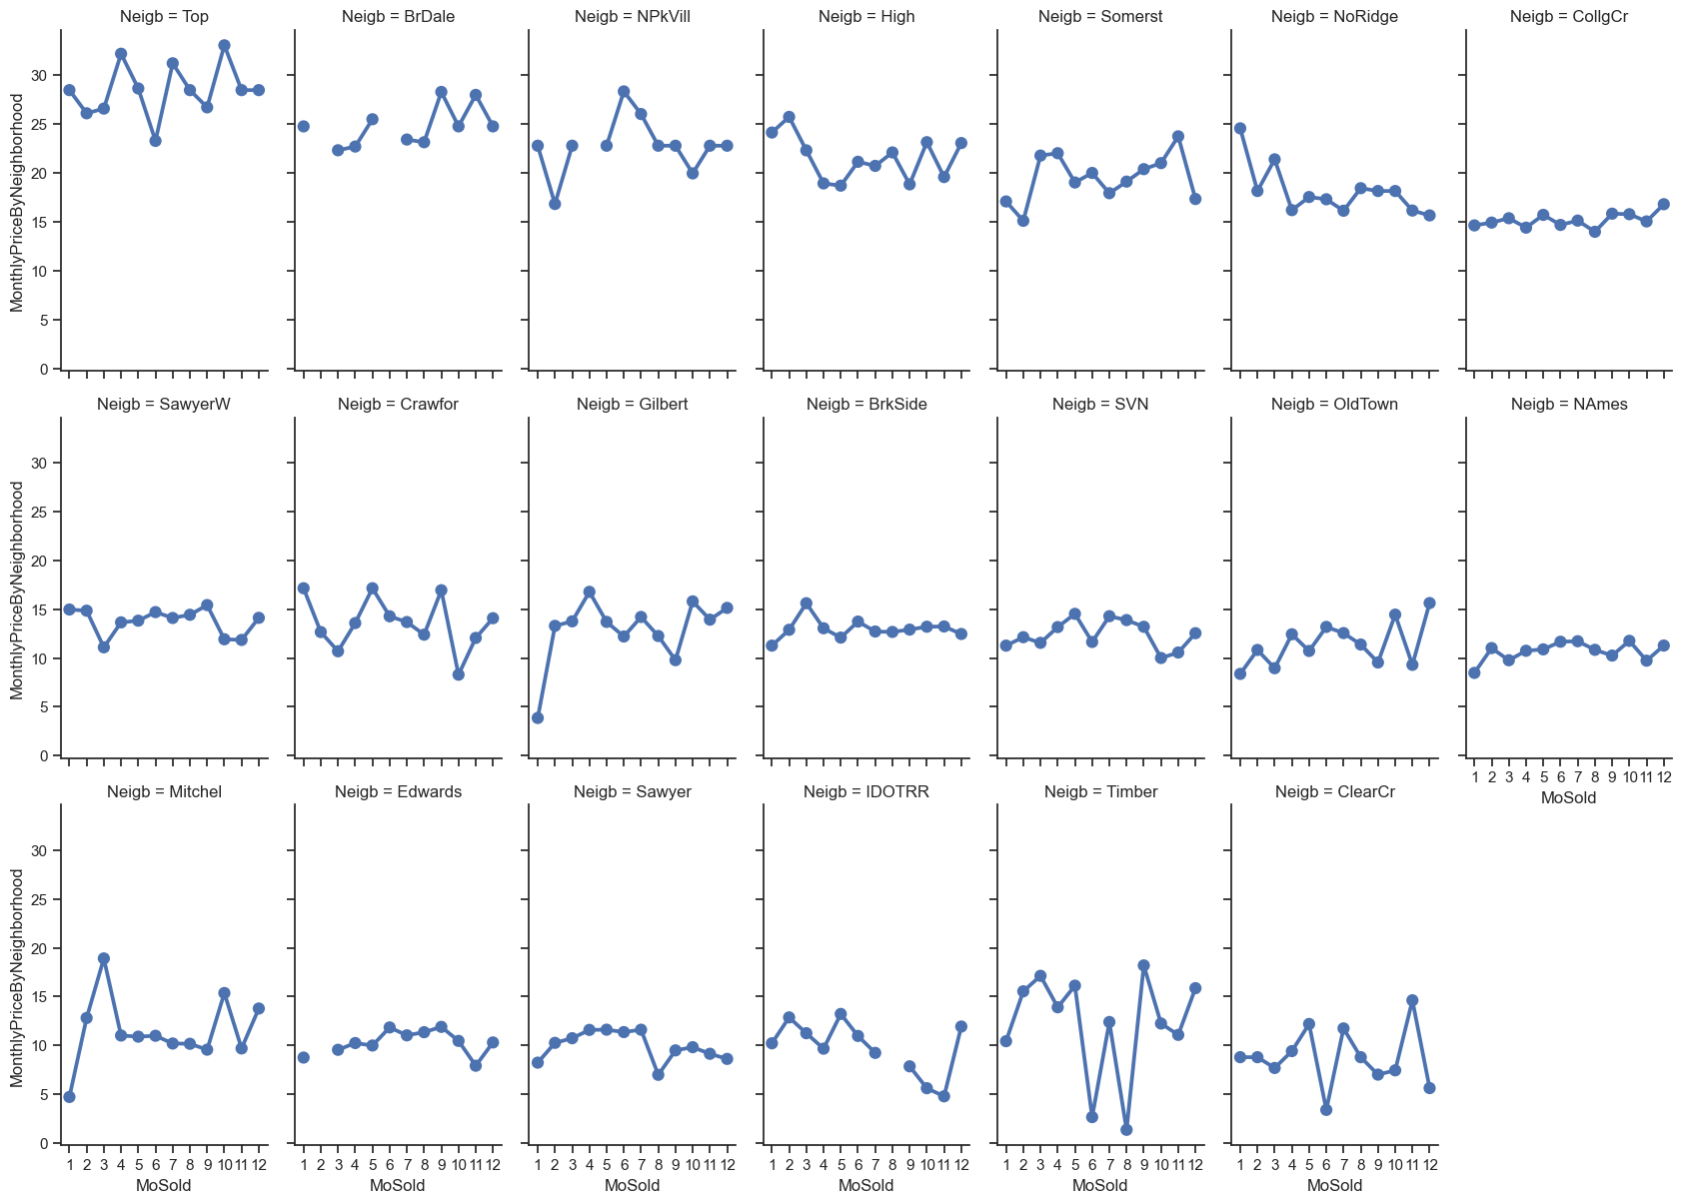
As we expected, the seasonality does have some effect, but of course we draw this conclusion based only on the above graphs is precipitated if not erroneous, given that even having restricted the views still exist houses with different characteristics in the same neighborhood. However, this is sufficient to understand that the timing of the sale matters, so the model will probably have to take this into account, or this will be part of the residual errors.

Slide 13
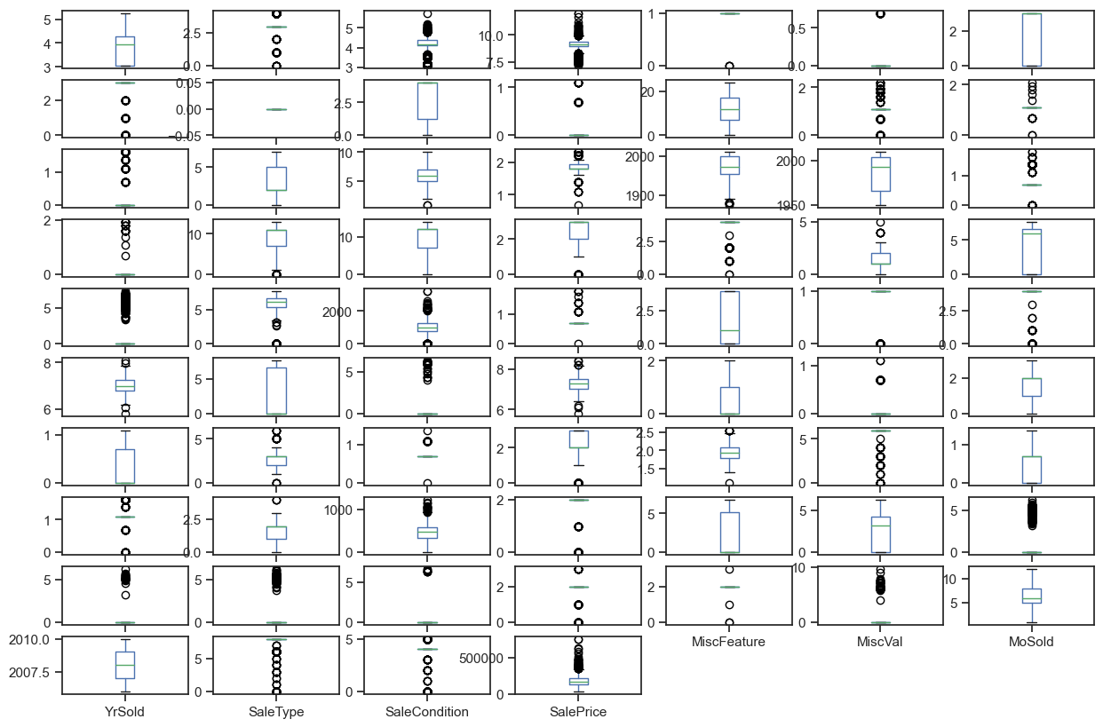
Box-Plot For Outliers check

